Slide 1
hi how r u, Steven Hawking
Stativko danila 6bi

Slide 2
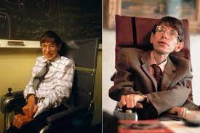
Who was he?
Steven Hawking (1942-2018) – really good and famous theoretical physicist, astrophysicist and cosmologist. “He was reading a book, when death caught him” – said his daughter Lyci.
He was really good person, but his disease knocked him out of his live.. yeah..

Slide 3
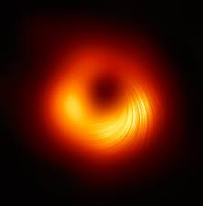
His cool teories
Stephen proposed the big bang theory on which many scientists rely.
He also found the so-called Hawking Radiation. He suggested, and then proved that the radiation of black holes, due to which they gradually evaporate, lose mass, and therefore information about the objects that fell into it.
And many others…

Slide 4
Sources
https://google.com
https://en.Wikipedia.com
And others

